Slide 1
PLAYER DETECTION WITH HOG, CAMSHIFT AND KALMAN FILTERS
Lorenzo Gandini
Signal, Image and Video
mat. 248430
a.y. 2023 / 2024
Notes:
For my course project in Signals, Images, and Video, I created a software that detects football players using the Histogram of Oriented Gradients, CAMShift and Kalman filters.

Slide 2
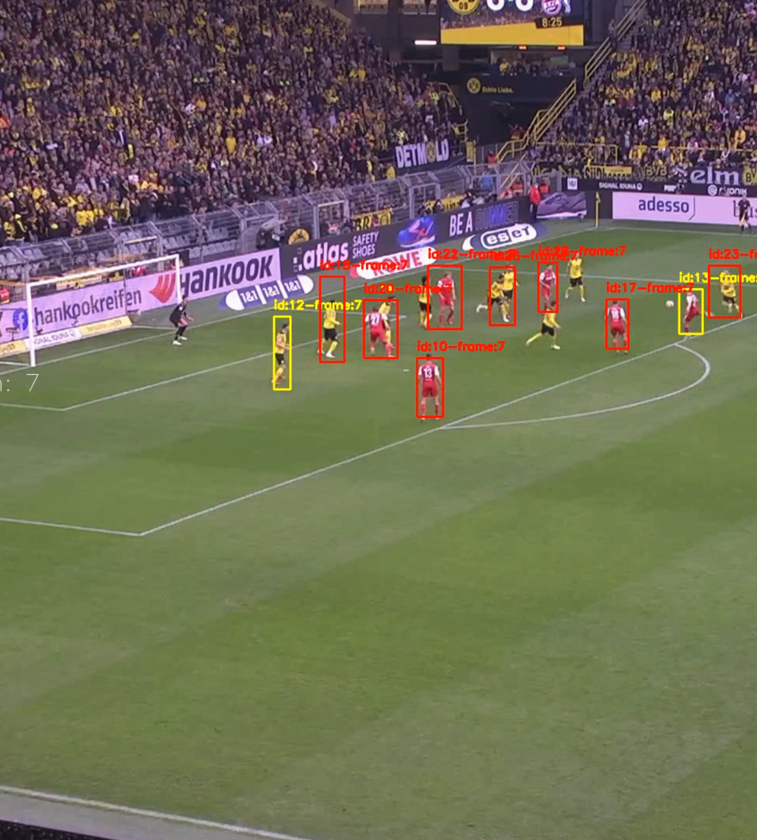
02
The goal
Recognize football players in a video
Track them with bounding boxes
Identify the jersey team’s color
Notes:
As the title sais the goal of my project is to identify football players in a selected video and track them with colored bounding boxes corresponding to their team jersey’s colors.

Slide 3
03
Workflow
Tracking players
( CAMShift &
Kalman )
Player detection
( HOG )
Bounding
Boxes
Main operations of the software
Pre
processing
of the
image
Detection
with
HOG
Pre
processing
of the
image
Track
position
with
CAMShift
Predict
position
with
Kalman
Update
colors
Clean
False
Positive
Extract
court
Draw
boxes
Notes:
My software operates in three main steps: The First one, is the player detection, where I used HOG to identify players inside the football court area.
The second phase is related to players with Camshift and with the help of Kalman filters enhance the quality of the tracking process.
The final step is dedicated to optimizing the results by removing all the false positives and draw the colored bounding boxes on the video.

Slide 4
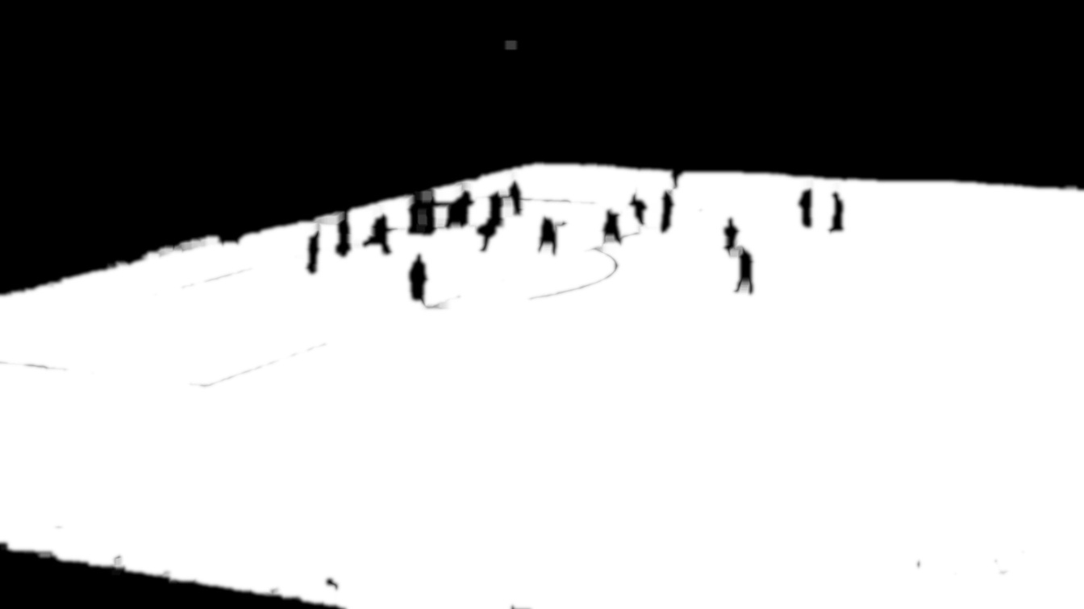
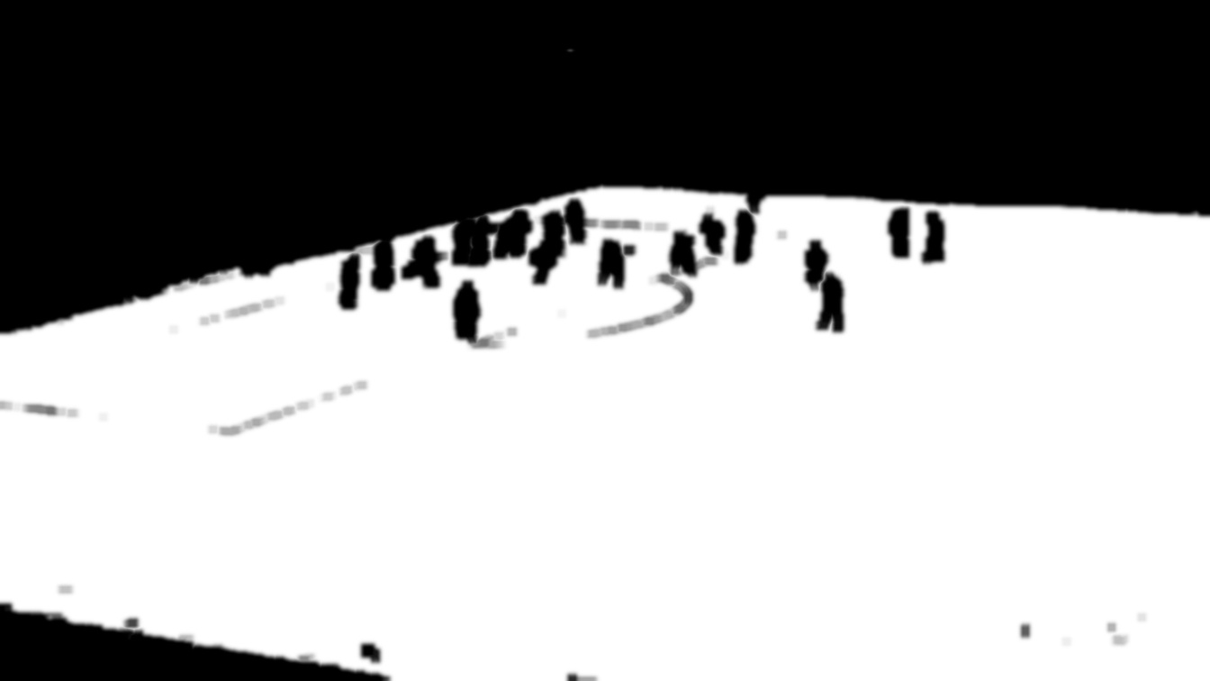
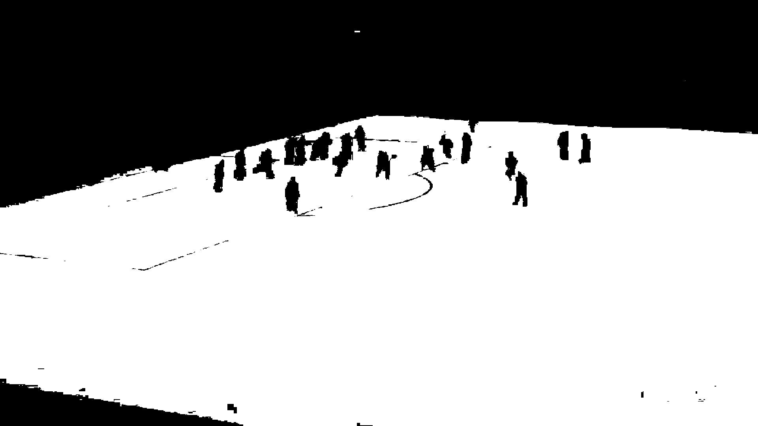
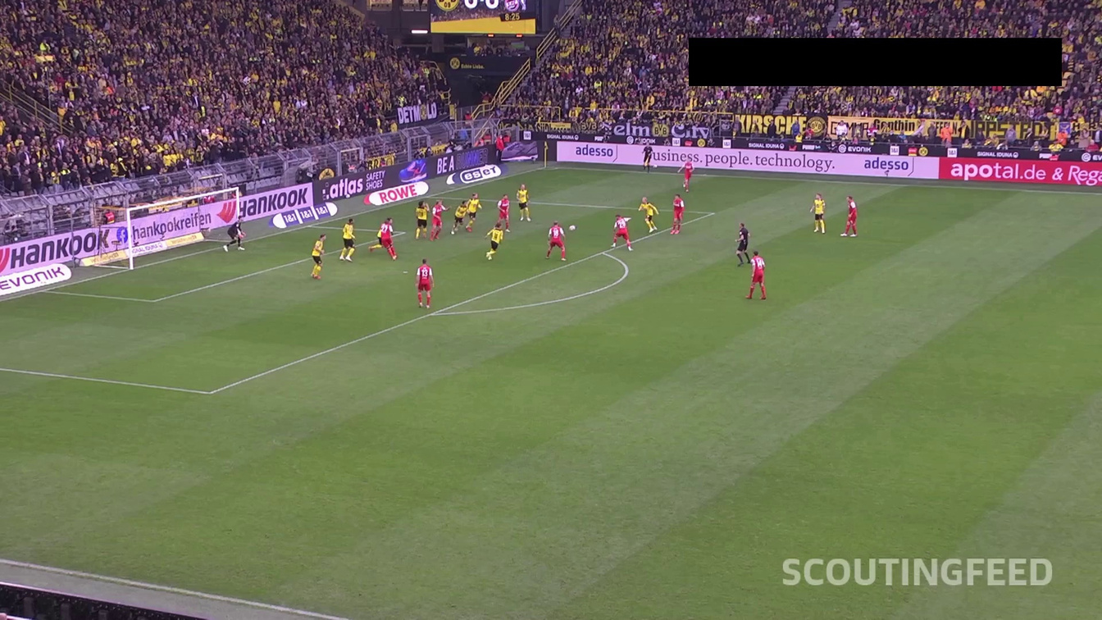
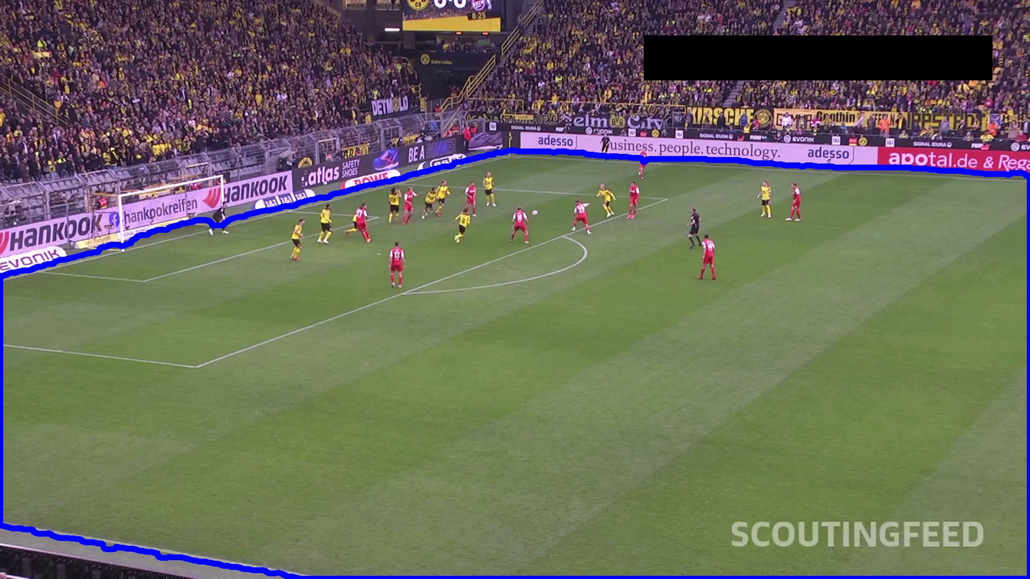
04
Extract Court
Tracking
players
( CAMShift &
Kalman )
Player
detection
( HOG )
Bounding
Boxes
Dilatation
Extract court
Erosion
Green mask
Original frame
Notes:
The initial step was to define the field as the region of interest for the detection avoiding in this way the crowd and potential false detections of bystanders.
Frame -> green mask of the field -> opening (erosion and dilatation) to remove artifacts and smmoth obstacles since this white area will be my region of interest for the detection.

Slide 5
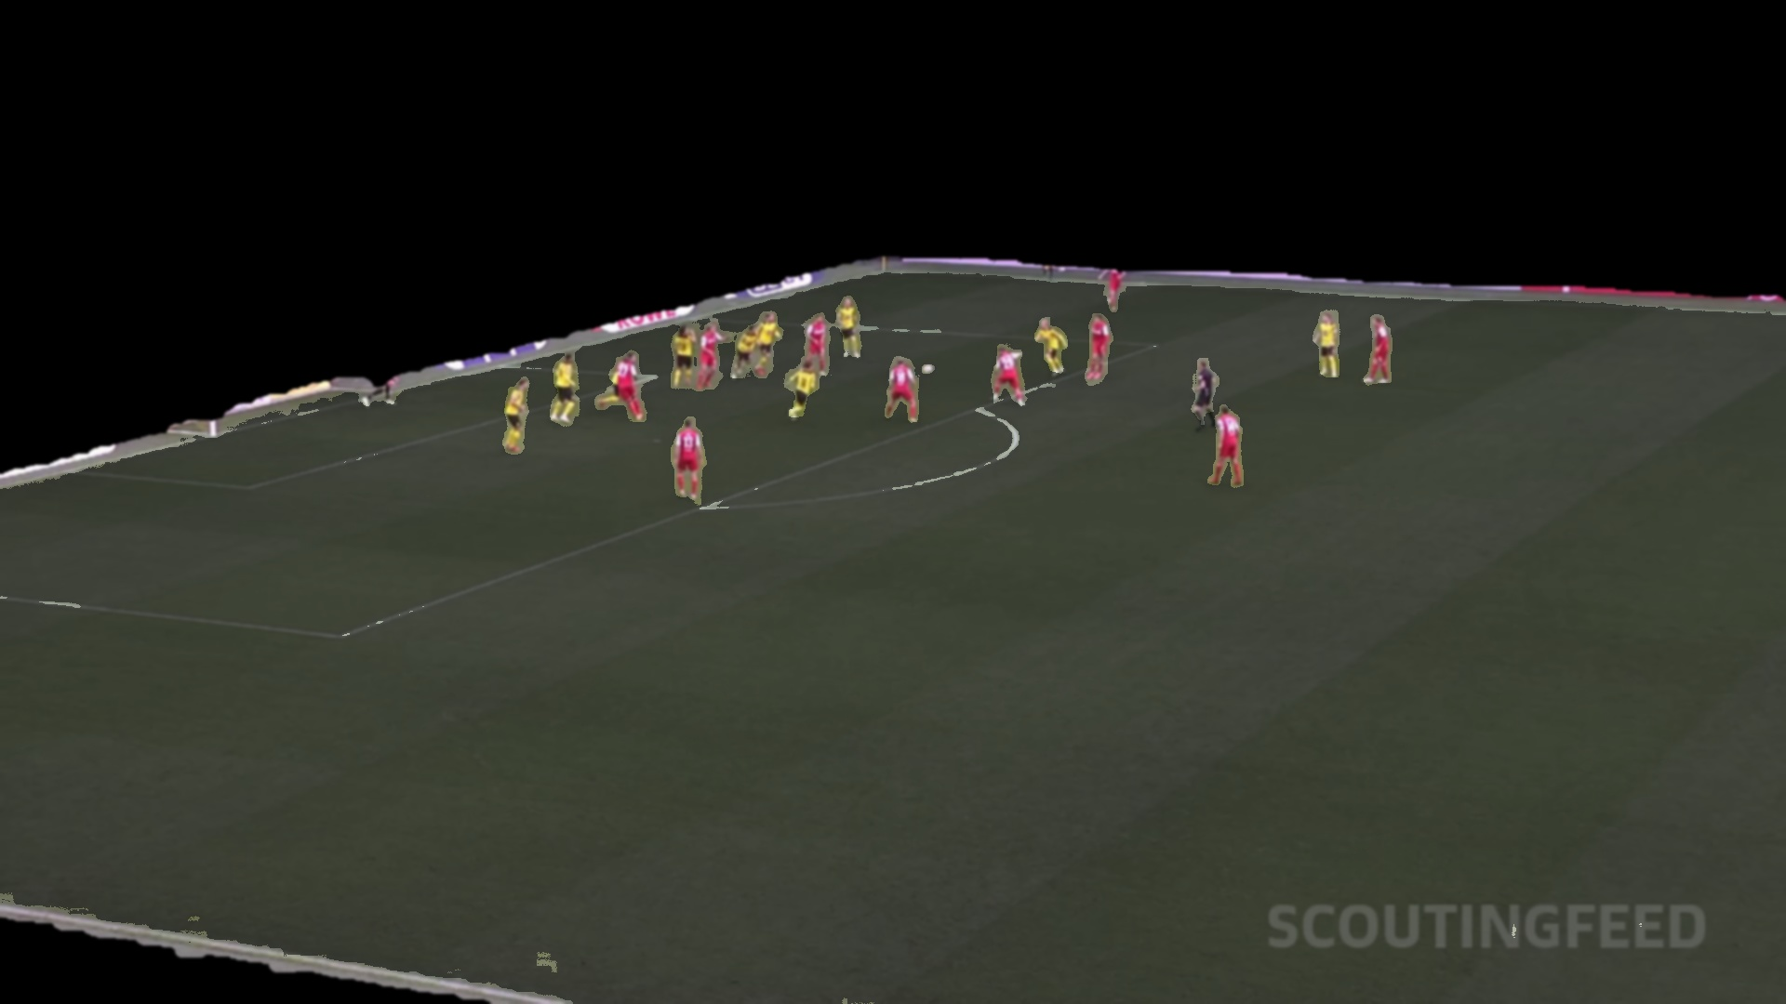
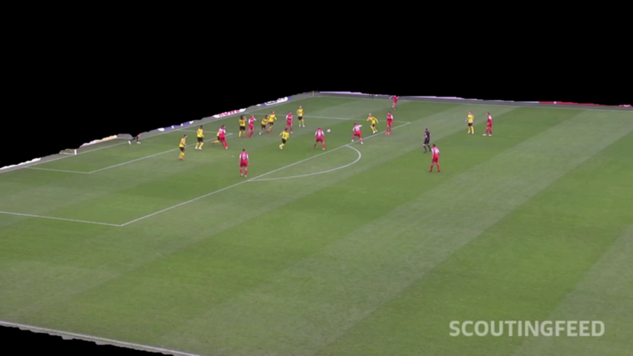
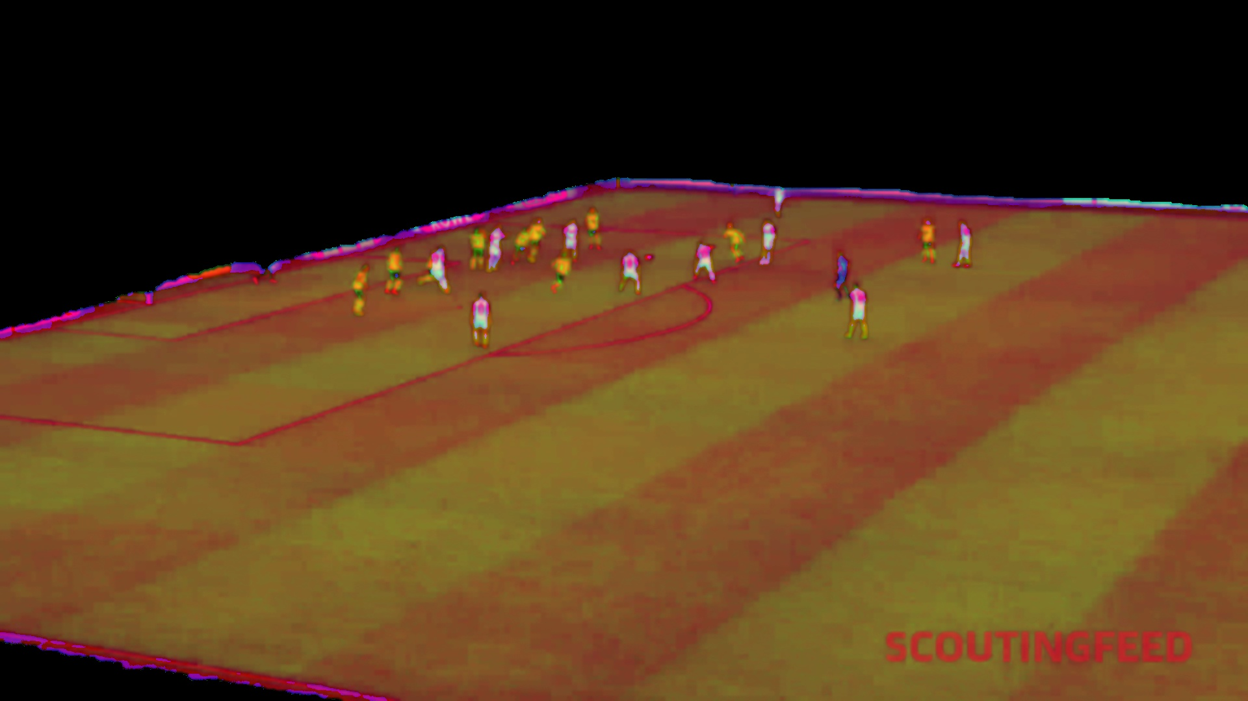
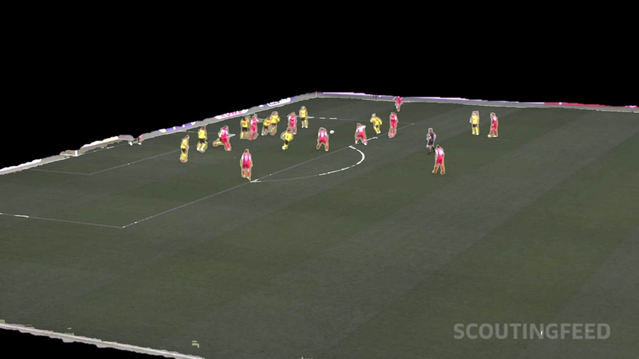
05
Pre-processing of the image
Tracking
players
( CAMShift &
Kalman )
Player
detection
( HOG )
Bounding
Boxes
Reduction of luminance and saturation
Enhanced contrast
From RGB to HSV
Extracted ROI
Notes:
Once the region of interest was defined, I tried to make the players more clear for the detection. After denoised it with a gaussian blur and switching from RGB to HSV color space, I decreased the luminance and saturation of the field and enhanced the contrast of the players, making them more clear and visible against the background.

Slide 6
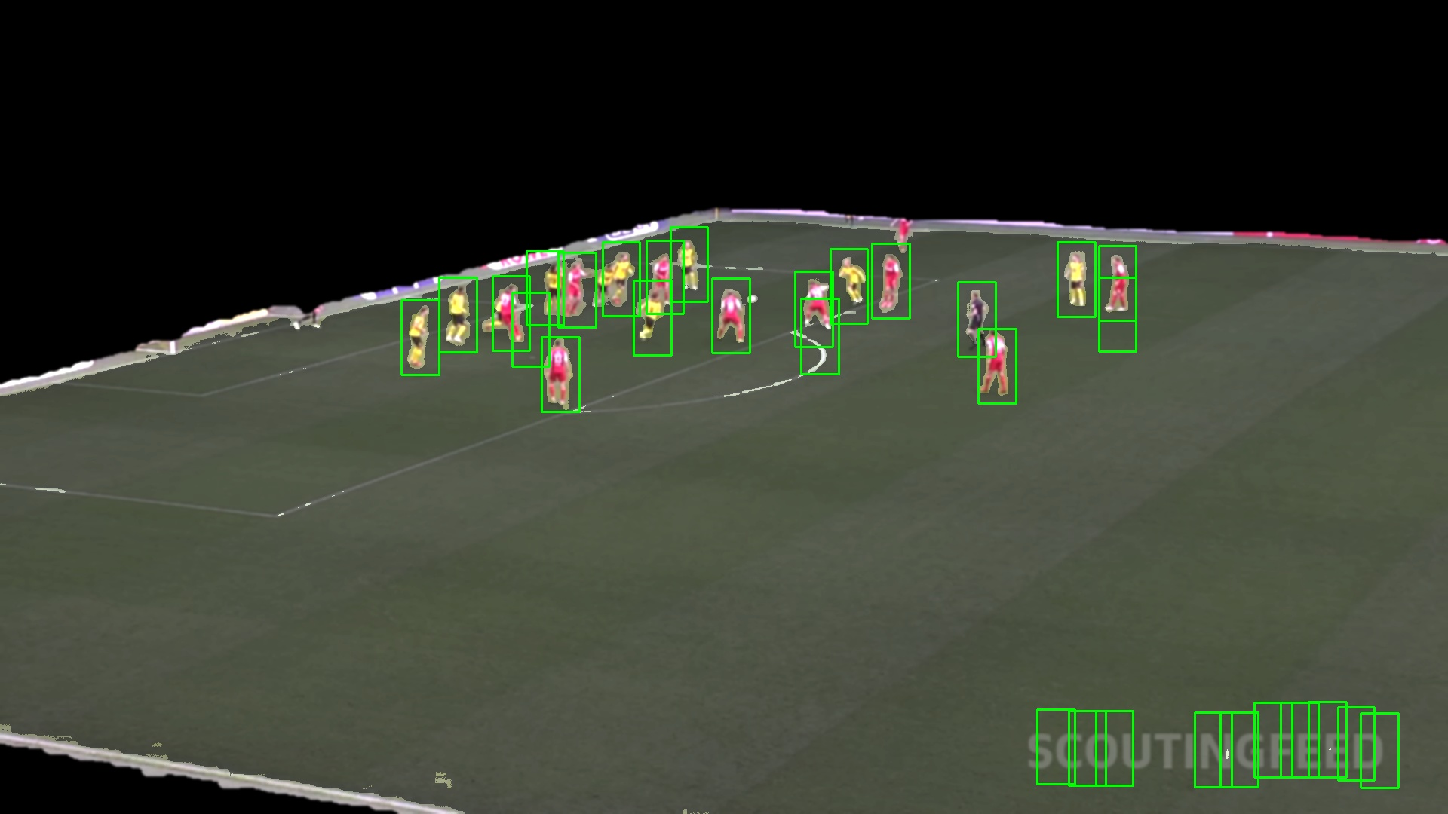
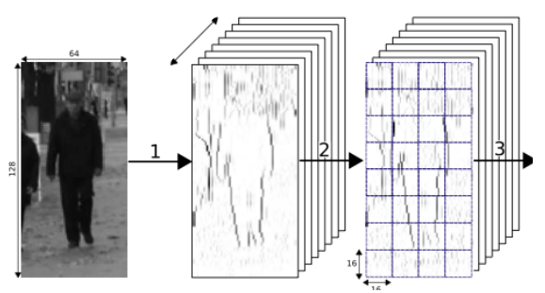


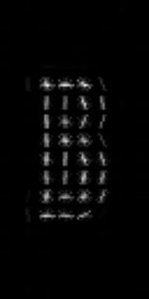
06
Identification with HOG
Tracking
players
( CAMShift &
Kalman )
Player
detection
( HOG )
Bounding
Boxes
Calculate gradient direction and magnitude for each pixel in cell
Coordinates of potential players to track
Based on Daimler’s pedestrian dataset
Divide image in cells
Notes:
-The main point in this first phase was the implementation of the histogram of oriented gradients.
-HOG works by dividing an image into small regions, the cells, and --calculates the direction and magnitude for each pixel inside these cells where the distribution of these gradient directions is then compiled into a histogram.-- In this way, HOG it is able to capture the edge directions and the silhouette of objects.
For my project, I used a pre-trained SVM classifier from the Daimler predestrians dataset present in the OpenCv library, in order to match the shape identified by hog with the silhouette of pedestrians, resulting in a set of coordinates that could be potential players

Slide 7
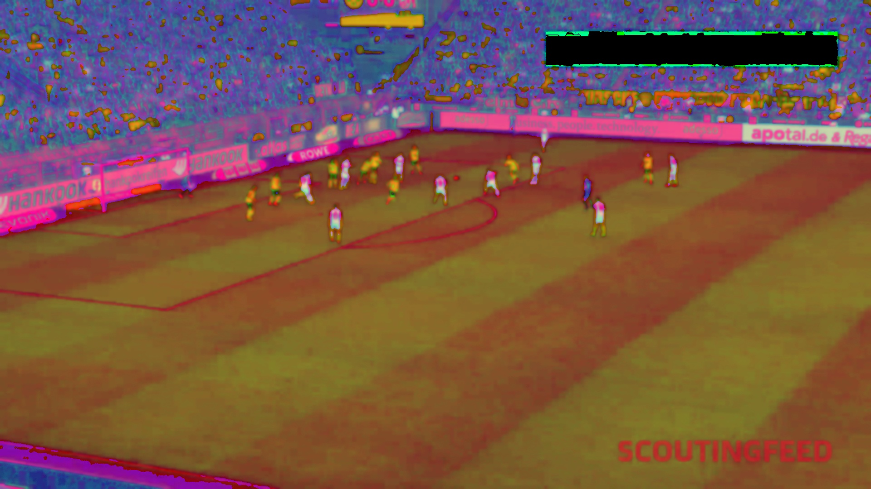
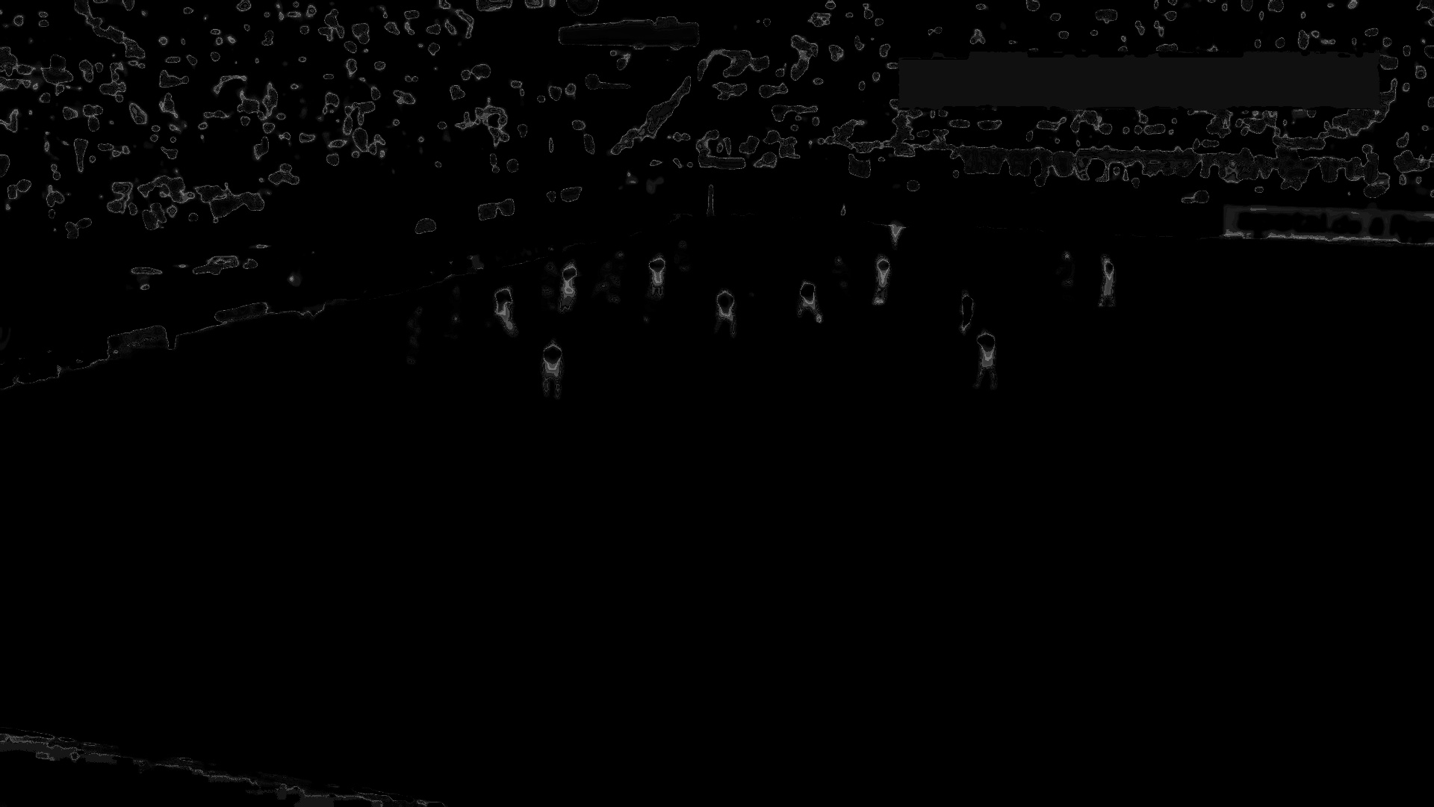
07
Pre-processing of the image
Player
detection
( HOG )
Tracking
players
( CAMShift &
Kalman )
Bounding
Boxes
Original frame
From RGB to HSV
Back projection
Notes:
To streamline the player tracking process, I began by pre-processing the video frames. After reducing the noise in the original frame and converting it from RGB to HSV color space, I performed a back projection which is a statistical model of the color distribution of image

Slide 8

08
Track position with CAMShift
Player
detection
( HOG )
Tracking
players
( CAMShift &
Kalman )
Bounding
Boxes
Highest concentration of a color probability distribution
Notes:
CAMShift works by continously searching for the highest concentration of a color probability distribution, within the back projection of every box defined by the coordinates of detected players.
Unlike Mean Shift,… (static size of tracking window )…. dinamically adjusts its tracking window to accommodate changes in the size of the target object. As players move—approaching or moving away from the camera—the algorithm adapts to maintain tracking.
However… some challenges. For example like in this case with the player with a blue bounding box around, when a player overlaps with teammates or is adjacent to advertising billboards, CAMShift may mistakenly interprets it as a unique object to been tracked leading to an inaccuracy of the tracking process.

Slide 9
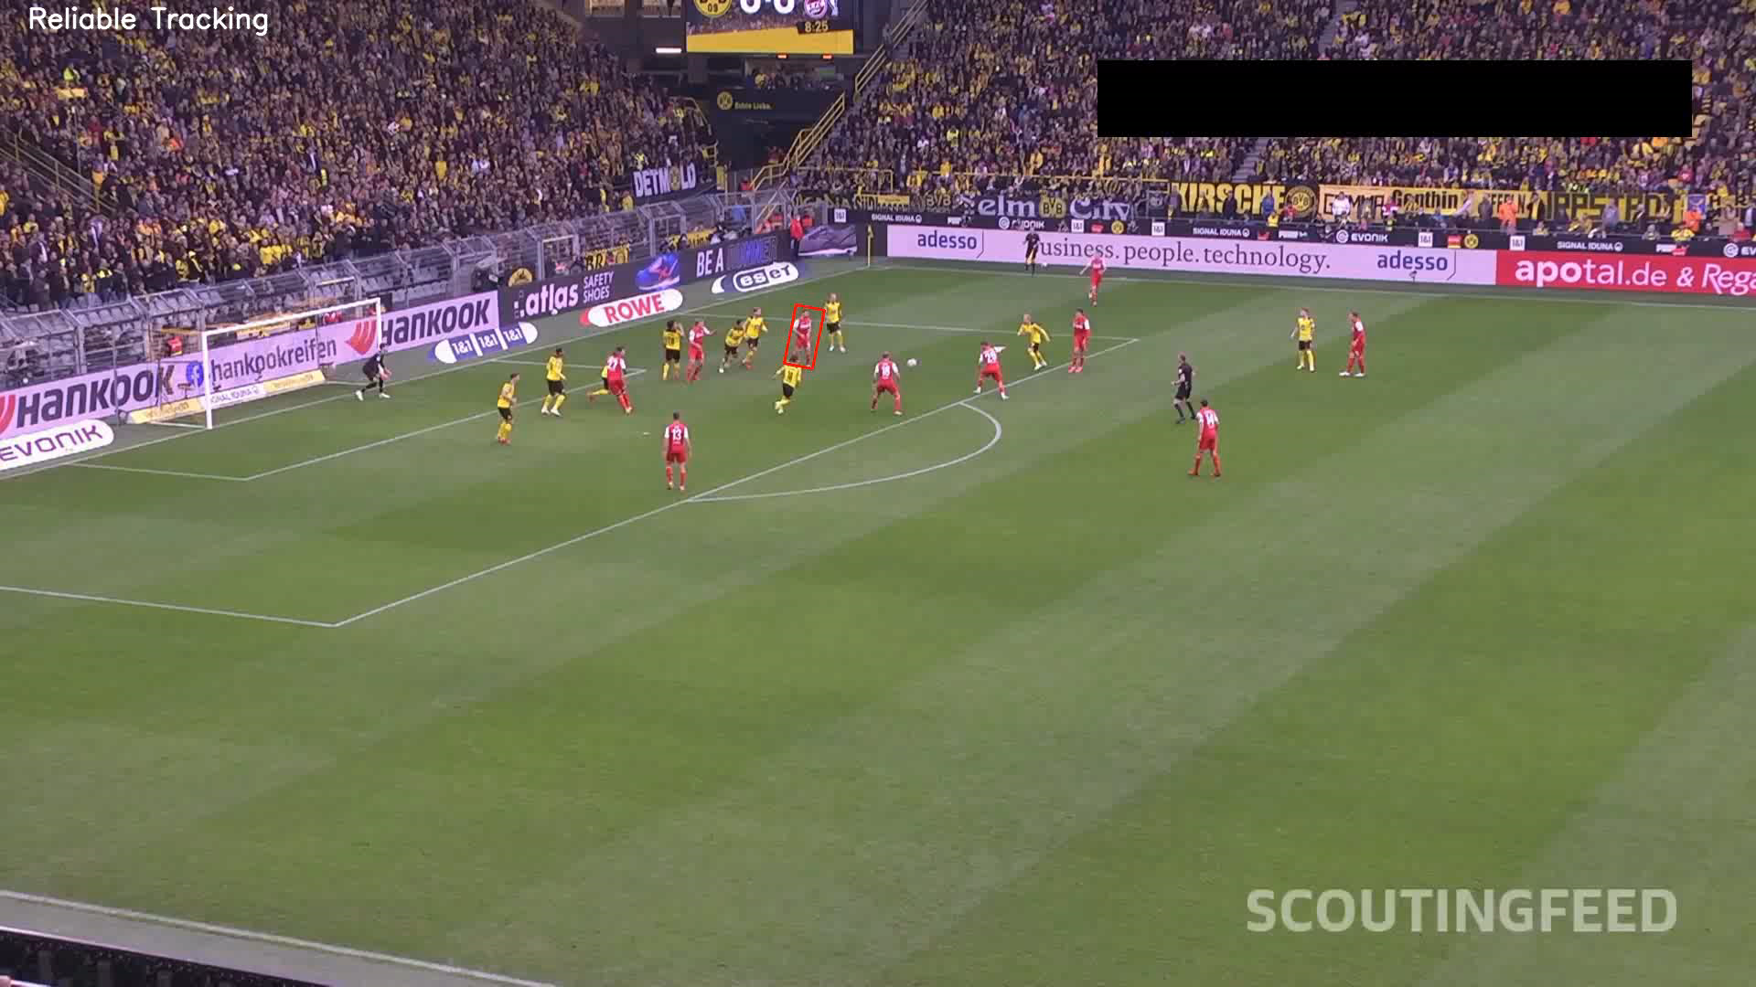
09
Predict position with Kalman and update boxes
Player
detection
( HOG )
Tracking
players
( CAMShift &
Kalman )
Bounding
Boxes
Estimate the future state of a marked object
Notes:
- For this purpose, I integrate my system with a Kalman filter which is a predictive algorithm able to estimate the future state of a marked object.
- It predicts the future position of the player based on what he has done previously and also with a dynamic model defined during the initialization of the filter.
-After predicting the position and the future size of the player, I made a correspondence between what the camshift detected and what kalman predicted. If kalman's prediction is more reliable than the camshift tracking, the predicted coordinates are saved instead of the ones by camshift. In this way, the same player tracked before, will still be tracked but the bounding box around will not growing out of control.

Slide 10
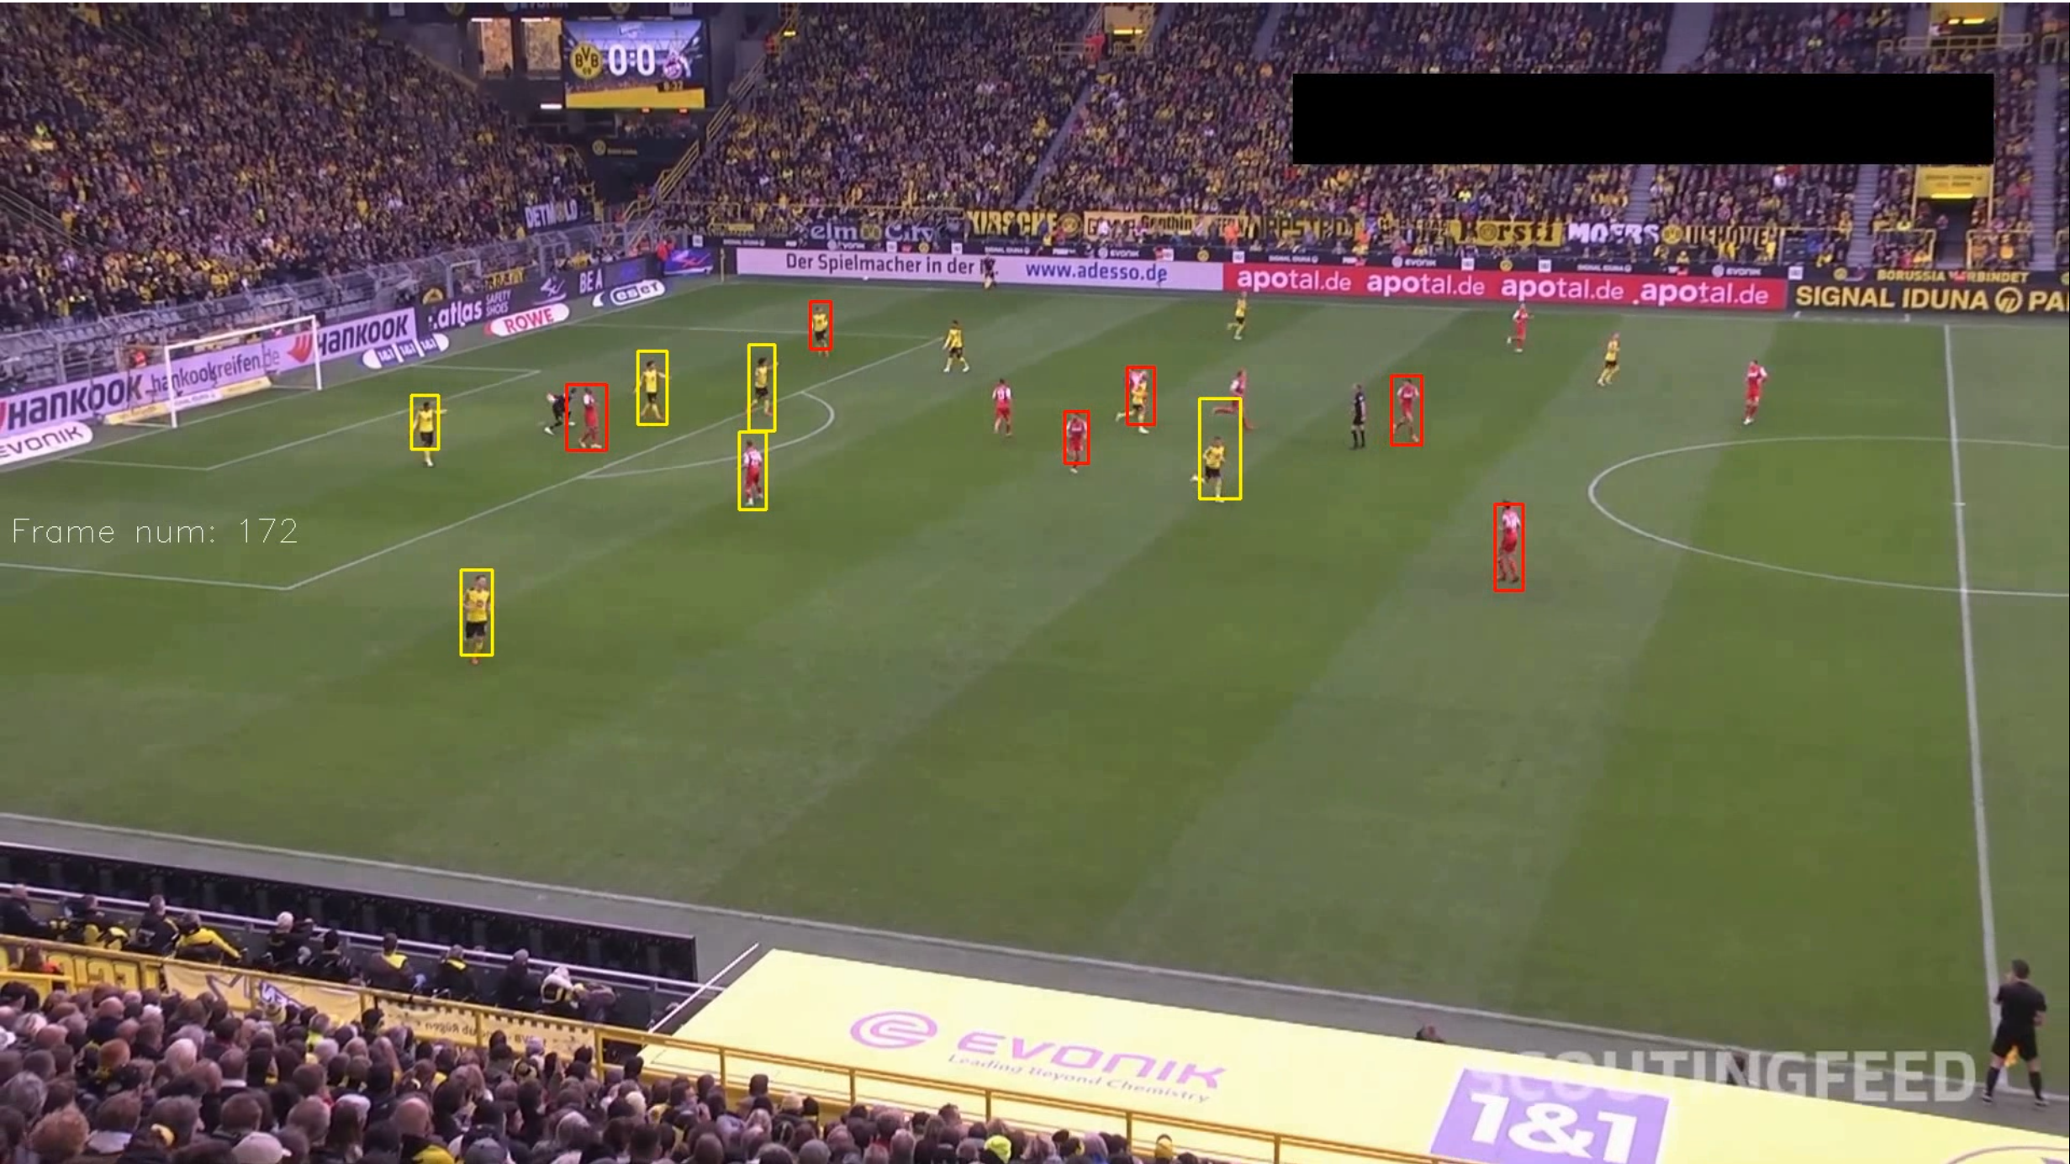
10
Define colors
Player
detection
( HOG )
Tracking
players
( CAMShift &
Kalman )
Bounding
Boxes
Color statistics of each b-box
Notes:
To define the team's jersey colour, I performed an analysis based on the average, the median, and the mode of the colors inside each bounding box.
Measuring the Euclidean distance for each value from standard RGB values for yellow and red (since they are the team colors inside the video).
The bounding box’s color is decided based on which color aligns with at least two of these statistics.

Slide 11
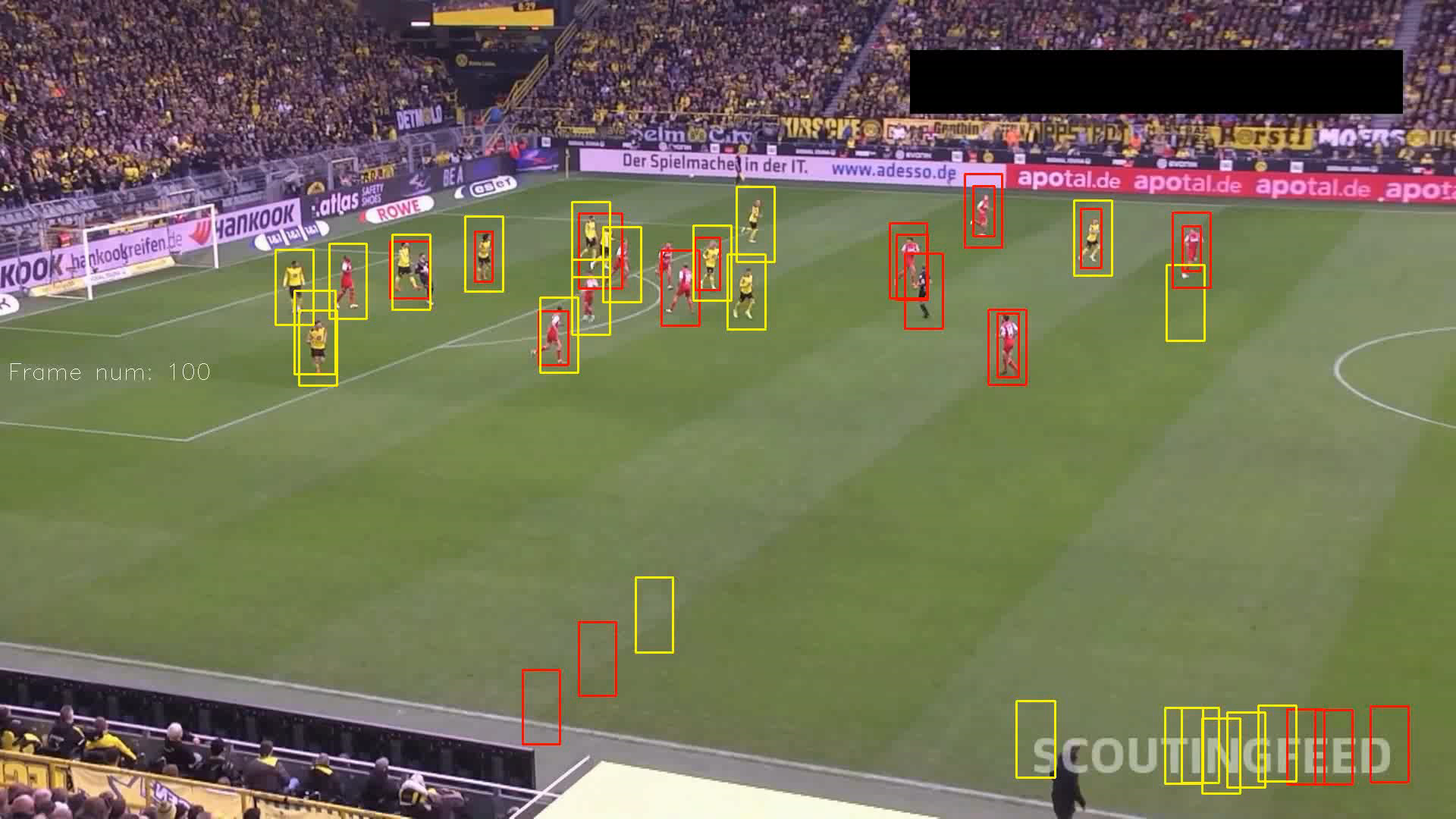
11
Clean
false-positive
Tracking
players
( CAMShift &
Kalman )
Player
detection
( HOG )
Bounding
Boxes
Checks on coordinates and areas of b-boxes
Notes:
As a last operation, before drawing the results, I removed all the false-positive boxes that were been tracked. As shown in these example, false positive could be ones that mantains always the same coordinates, resulting in a stick position like the ones around the watermark. Or boxes that moves but doesnt change area despite the adaptive windows size of camshift.

Slide 12
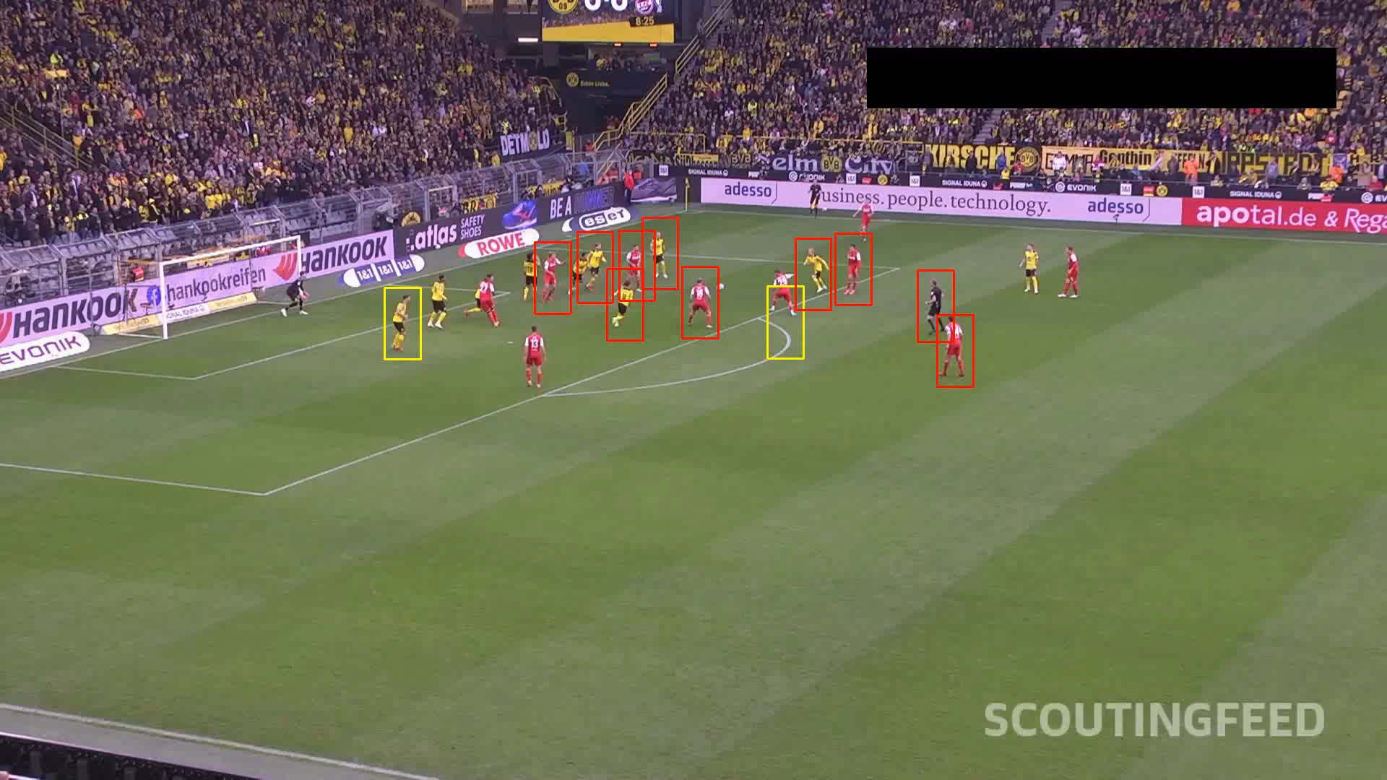
12
Final result
Tracking
players
( CAMShift &
Kalman )
Player
detection
( HOG )
Bounding
Boxes
Notes:
In the end, this is the final result of my project.
As can be observed, the result is far from perfect and there is a lot of space for improvement.

Slide 13



13
Critical aspects and possible improvements
Video quality
Improve the chosen algorithms
Use advanced algorithms
Notes:
First point of improvement is use a video with a fixed camera instead a streaming one with changes in zoom, focus and luminance and movement in both axes. Bring diffic. In color mask definition, also player position tracking biased by movement. First frame was an attacking with… instead a well distirbuted across the court like the typical… making them more easilly detectable.
2: To improve and deal with varying light condition, a solution could be integrate an adaptive thresholding that dynamically adjust the parameters used for the colors.
Also use environmental normalization techniques, like geometric projections could be used in order to manage the variations of the camera. Another … identification.. train HOG with football pl. dataset. Another …. Tracking… integrate with an otpical flow…
3: A better result surely will be obtained with the incorporation of Convolutional Neural Networks since this structure offers a substantial upgrade over traditional methods in recognizing players and their colors from complex backgrounds even in the presence of occlusions and varying appearances like in a soccer video.

Slide 14
Thank you

